Slide 1
Containers on AWS
Computing (Containers and Serverless)
Notes:
The module will now explore containers on AWS and how they can be used in systems operations.

Slide 2


Shipping containers
Before shipping containers
After shipping containers
Goods were shipped in a variety of vessels with no standardized weight, shape, or size.
Transporting goods was slow, inefficient, and costly.
Uniformly sized shipping containers simplified loading, unloading, storing, and transferring between transport types.
Abstraction of shipment details improved efficiency, increased productivity, and reduced costs.
Notes:
In the physical world, a container is a standardized unit of storage. Container sounds like a generic term, but its importance is clearer if you look at how containers changed the shipping industry.
Before the introduction of the modern shipping container in 1956, transporting goods from one point to another was a challenge. Goods were shipped in sacks, crates, cartons, drums, casks, barrels, and boxes of various weights, shapes, and sizes. They often were loaded by hand into whatever vessel was carrying them. The vessel wouldn’t know how much cargo it could take until all of the cargo was loaded. Transporting goods this way was slow, inefficient, and costly.
Shipping containers revolutionized the shipping industry. Their uniform size made it much more efficient to load, unload, and stack them. Containers could also be easily moved between ships, trucks, and railroad cars. In this way, containers improved efficiency, increased productivity, and reduced costs.
Source: https://www.worldshipping.org/educational-resources
This resource contains a great example of using abstraction to increase agility. Abstraction, in this sense, means that the people who are involved in shipping are further removed from the details of the transaction. This abstraction applies to the people who send the contents and those who actually facilitate the shipping itself. They don’t need to worry about whether items will fit in a given container or about the fit of the container onto various vessels. Abstraction is a way of hiding the working details of a subsystem. It separates concerns to facilitate interoperability and platform independence.

Slide 3



Introduction to containers
Containers are:
A method of operating system virtualization.
An application and its dependencies that can be run in resource-isolated processes.
Container 1
Container 2
Container 3
© 2024, Amazon Web Services, Inc. or its affiliates. All rights reserved.
Notes:
Just as virtual machines virtualize hardware, containers virtualize an operating system. Amazon EC2 runs virtual machines, where an entire operating system—such as Linux or Windows—has been virtualized.
Containers are smaller, and do not contain an entire operating system. Instead, containers share a virtualized operating system and run as resource-isolated processes, which ensures quick, reliable, and consistent deployments. Containers hold everything that the software needs to run, such as libraries, system tools, code, and the runtime.

Slide 4
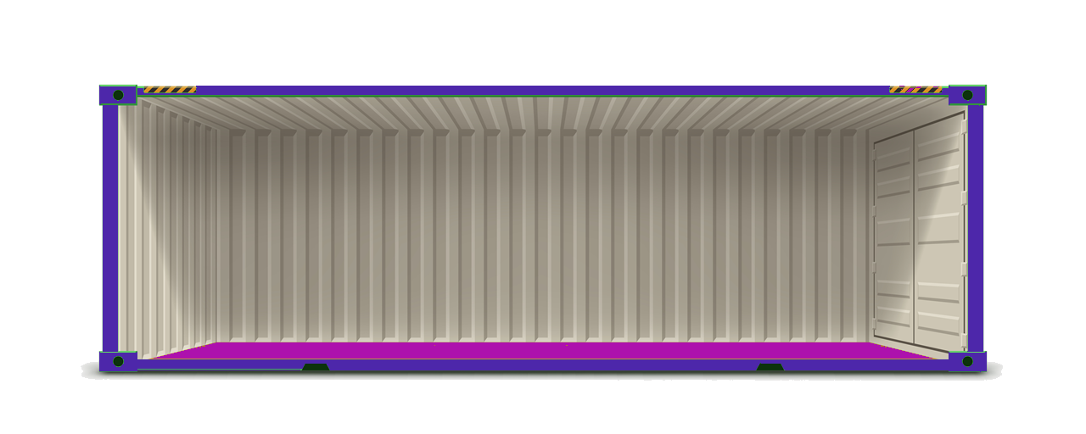
A container is a standardized unit of software
Runtime engine
Application code
System tools
System libraries
Notes:
This concept can move from the physical world to the virtual world of computing platforms. Virtually, a container is a standardized unit of software designed to run quickly and reliably on any computing environment that runs the containerization platform.
Containers provide operating system (OS) virtualization so that you can run an application and its dependencies in resource-isolated processes. A container is a lightweight, standalone software package that contains everything that a software application needs to run. For example, it can contain the application code, runtime engine, system tools, system libraries, and settings. Containers can help ensure that applications deploy quickly, reliably, and consistently regardless of the deployment environment.
A single server can host several containers that all share the underlying host system’s OS kernel. These containers might be services that are part of a larger enterprise application, or they might be separate applications that run in their isolated environment.

Slide 5
Evolution of deployment models: Bare-metal servers
Applications compete for server resources
Applications A, B, C
Library versions must be shared across applications
Libraries
Host OS
Inflexible hardware costs
Host server
Notes:
Increasing levels of abstraction are often associated with technical maturity. The move toward containers is part of the evolution of deployment models.
In earlier phases, you had bare-metal servers. You had to build the architectural layers, such as the infrastructure and application software layers. For example, you would install an OS on top of your server hardware. Then, you would install any shared libraries on the OS, and then install the applications that use those libraries. This architecture was inefficient.
Your hardware costs are the same whether you are running at 0 percent utilization or 100 percent utilization. All of your applications must compete for the same resources, and you must keep the versions of your libraries in sync with all your applications. If one application requires an updated version of a library that is incompatible with other applications running on that host, then you run into problems.

Slide 6
Evolution of deployment models: VMs
Isolated applications
VM
VM
VM
Isolated libraries
Application A
Application B
Application C
Libraries
Libraries
Libraries
More OS maintenance
More server space for OS
Guest OS
Guest OS
Guest OS
Virtualization platform
Better resource utilization
Host OS
Host server
Notes:
These shortcomings led to the use of a virtualization platform over the host OS. Now, you have isolated applications and their libraries, which have their own full OS inside a VM. This arrangement improves utilization because you can add more VMs to run on top of the existing hardware, which greatly reduces your physical footprint. The downside to VMs is that the virtualization layer is heavy. In this example, you now have three operating systems on the physical host server, instead of one. That means more patching, more updates, and significantly more space that is taken up on the physical host. It also can cause significant redundancy: you have installed potentially the same OS three times, and potentially the same library three times.

Slide 7
Evolution of deployment models: Containers
Lightweight, efficient, and fast
Highly portable ; applications run identically across environments
Container
Container
Container
Application A
Application B
Application C
Bins/libs
Bins/libs
Bins/libs
Shared or isolated libraries
Shared libraries
Containerization platform
Shared OS kernel
Host OS
Host server
Better resource utilization
Notes:
Containers improved upon the idea of virtualization. The container runtime shares the host operating system’s kernel. You can use this arrangement to your advantage to create container images by using file system layers. Containers are lightweight, efficient, and fast. They can be started up and shut down faster than VMs, which means better utilization of the underlying hardware. You can share libraries when needed, but you can also have library isolation for your applications. Containers are also highly portable. Because containers isolate software from other layers, their code runs identically across different environments—from developing and staging all the way to production.

Slide 8
Benefits of using containers
Environment consistency
Operational efficiency
Developer productivity
Version control
Containers:
Container 1
Container 2
Container 3
© 2024, Amazon Web Services, Inc. or its affiliates. All rights reserved.
Notes:
Containers deliver environmental consistency because the application’s code, configurations, and dependencies are packaged into a single object.
Containers serve as a building block that can be deployed on any compute resource regardless of software, operating system, or hardware configurations.
Containers also provide process isolation.
There are no shared dependencies or incompatibilities because each container is isolated from the other.
Whatever you package as a container locally will deploy and run the same way, whether in testing or production.
Process isolation provides operational efficiency.
Containers also allow to you run multiple applications on the same instance.
You can specify the exact amount of memory, disk space, and CPU that will be used by a container on an instance.
Containers boot quickly, and the reduced footprint enables you to quickly create and terminate applications or tasks that are encapsulated in a container. These features enable you to rapidly scale applications up and down.
Containers increase developer productivity by removing cross-service dependencies and conflicts.
Each application component can be broken into different containers that run a different microservice.
Containers are isolated from each other, so you do not have to worry about libraries or dependencies being in sync for each service.
Developers can independently upgrade each service because there are no library conflicts.
Containers allow you to track versions of your application code and their dependencies. Docker container images have a manifest file (Dockerfile) that allows you to:
Easily maintain and track versions of a container
Inspect differences between versions
Rollback to previous versions

Slide 9
Docker
Containers have everything the software needs to run:
Libraries
System tools
Code
Runtime
Docker is:
A software platform that allows you to build, test, and deploy applications quickly.
Used to package software into standardized units called containers.
Container 1
Container 2
Container 3
© 2024, Amazon Web Services, Inc. or its affiliates. All rights reserved.
Notes:
Docker is a software platform that packages software (such as applications) into units that are called containers. This software platform allows for the quick building, testing, and deployment of applications. The containers hold everything that the software needs to run. Docker is installed on each server that will host containers, and it provides simple commands that you can use to build, start, or stop containers.
By using Docker, you can quickly deploy and scale applications into any environment.
Docker is best used as a solution when you want to:
Standardize environments
Reduce conflicts between language stacks and versions
Use containers as a service
Run microservices using standardized code deployments
Require portability for data processing

Slide 10
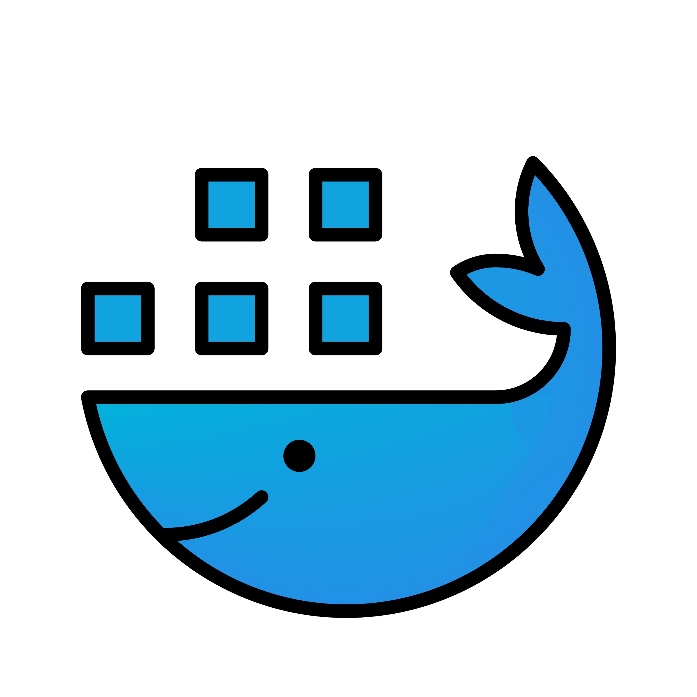
Docker container benefits
Portable runtime application environment
Application and dependencies can be packaged in a single, immutable artifact
Ability to run different application versions with different dependencies simultaneously
Faster development and deployment cycles
Better resource utilization and efficiency
Notes:
The following list summarizes some of the important benefits of Docker containers:
Docker is a portable runtime application environment.
You can package an application and its dependencies into a single, immutable artifact that is called an image.
After you create a container image, it can go anywhere that Docker is supported.
You can run different application versions with different dependencies simultaneously.
These benefits lead to much faster development and deployment cycles, and better resource utilization and efficiency. All of these abilities are related to agility.

Slide 11
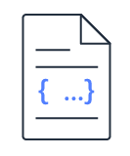
Docker container components
Layer 4
Layer 3
Layer 2
Layer 1
Dockerfile
Plain text file that provides instructions to create a container image
Container image
Read-only template that is used to create writable containers
Container layer
Thin read/write layer that is used to make changes to the running container
Container Runnable instance of an image
Container registry Private or public images that you can base other images on
Notes:
Docker containers are created from read-only templates, which are called container images. Images are immutable and highly portable. You can port an image to any environment that supports Docker. Images are composed of layers.
Images are built from a Dockerfile, which is a plain text file that specifies all of the components that are included in the container. Instructions in the Dockerfile create layers in the container image.
You can create images from scratch, or you can use images that others created and published to a public or private container registry.
An image is usually based on another image, with some customization. For example, you might build an image that’s based on the Ubuntu Linux image in the registry. The image could also install a web server and your application, in addition to the essential configuration details to make your application run.
A container is a runnable instance of an image. You can create one container or several containers based on that image.
Each container has a thin, read/write layer on top of the existing image when it is instantiated. This architecture is what makes the actual process of instantiating the containers fast. Most of the actual work is read-only because of the file system layers. The read/write layer of the container enables your applications to function properly while they are running, but it’s not designed for long-term data storage. Persistent data should be stored in a volume somewhere. Consider a container as a discrete compute unit, not a storage unit.

Slide 12
Docker example deployments
Single host operating system, with Docker installed and how Docker would run on premises.
Four applications are hosted across three guest operating systems and how it would run on AWS.
Application A
Application B
Application C
Application A
Application B
Application C
Bins/Libs
Bins/Libs
Bins/Libs
Application D
Bins/Libs
Bins/Libs
Bins/Libs
Docker
Docker
Bins/Libs
Docker
Guest OS #1
Guest OS #2
Guest OS #3
Host OS
Hypervisor
Infrastructure
Infrastructure
© 2024, Amazon Web Services, Inc. or its affiliates. All rights reserved.
Notes:
In the graphic on the left, a single host operating system has Docker installed on it, and it also has three applications that run in three separate containers. Each container relies on the virtualized operating system provided by Docker, but each container also has its own isolated binaries and software dependency libraries.
In the graphic on the right, four applications are hosted across three guest operating systems. Each guest OS could be an Amazon EC2 instance. Applications A and B are hosted on a single guest OS. Application C is hosted on a separate guest OS. Application D runs in a non-container environment on a virtual machine, and as the graphic indicates, it does not use Docker.
NOTE: You can have a single application that spans multiple containers, which is not depicted in this graphic. You will commonly see deployments where multiple containers run on a single installation of Docker, as indicated by Guest OS #1, with Applications A and B.

Slide 13
Dockerfile simple example
# Start with the Ubuntu latest image
FROM ubuntu:latest
# Output hello world message
CMD echo "Hello World!"
Notes:
To build your own image, you create a Dockerfile by using a simple syntax to define how to create the image and run it. Each instruction in a Dockerfile creates a read-only layer in the image.
In this simple example, you start with the Ubuntu latest image that is already created for you, and hosted on Docker Hub or some other site. The only thing that you do is add a command to echo the message Hello World! after the container is instantiated.

Slide 14
Dockerfile example: Start a Java application
# Start with open JDK version 8 image
FROM openjdk:8
# Copy the .jar file that contains your code from your system to the container
COPY /hello.jar /usr/src/hello.jar
# Call Java to run your code
CMD java –cp /usr/src/hello.jar
Org.example.App
Notes:
This is a slightly more involved example, in which you want to run a Java application. You start with the open Java Development Kit (JDK) version 8 image. You copy the .jar file that contains your code from your system to the container and then call Java to run your code. When this container is instantiated, it runs the Java application.

Slide 15
Dockerfile example: Common tasks
# Start with CentOS 7 image
FROM centos:7
# Update the OS and install Apache
RUN yum –y update && yum –y install httpd
# Expose port 80—the port that the web server “listens to”
EXPOSE Port 80
# Copy shell script and give it run permissions
ADD run-httpd.sh /run-httpd.sh
RUN chmod –v +x /run-httpd.sh
# Run shell script
CMD ["/run-httpd.sh"]
Notes:
This is a more real-world example of a Dockerfile. You start with the CentOS 7 image. Next, you update the OS and install Apache. Then, you expose Port 80. Finally, you copy the shell script for your application and give it run permissions. After the container is instantiated, the command will run the shell script.

Slide 16
Each line of the Dockerfile adds a layer
Image layers (read-only)
# 1 Start with CentOS 7 image
FROM centos:7
# 2 Update the OS and install Apache
RUN yum –y update && yum –y install httpd
# 3 Expose port 80
EXPOSE Port 80
# 4 Copy shell script and give it run permissions
ADD run-httpd.sh /run-httpd.sh
RUN chmod –v +x /run-httpd.sh
CMD ["/run-httpd.sh"]
RUN chmod –v +x /run-httpd.sh
4
ADD run-httpd.sh /run-httpd.sh
4
EXPOSE 80
3
RUN yum –y update && yum –y install httpd
2
1
Base: CentOS 7
Notes:
This example shows what the previous example looks like in terms of layers. Each instruction in the Dockerfile creates a layer.
The first layer, starting from the bottom of the diagram, is the base layer
The next layer includes the software update and the Apache installation.
The next layer opens and exposes port 80.
The layer after that includes the command to copy the shell script.
Finally, the last layer makes the shell script run.
These layers are all read-only, which makes the container image an immutable object.
If you change the Dockerfile and rebuild the image, only the layers that have changed are rebuilt. This feature is part of what makes container images so lightweight, small, and fast compared to other virtualization technologies.

Slide 17
Docker CLI commands
Command | Description
docker build | Build an image from a Dockerfile.
docker images | List images on the Docker host.
docker run | Launch a container from an image.
docker ps | List the running containers.
docker stop | Stop a running container.
docker start | Start a container.
docker push | Push the image to a registry.
docker tag | Tag an image.
Command | Description
docker logs | View container log output.
docker port | List container port mappings.
docker inspect | Inspect container information.
docker exec | Run a command in a container.
docker rm | Remove one or more containers.
docker rmi | Remove one or more images from the host.
docker update | Dynamically update the container configuration.
docker commit | Create a new image from a container's changes.
Notes:
You can run Docker command line interface (CLI) commands from a Bash terminal to manage your Docker images and containers.
For example, you can build an image from a Dockerfile by running docker build. You can then verify your image by running docker images. To launch a container from the image, run docker run. To verify that the container is running, enter docker ps.
After you launch a container, you can interact with it in a variety of ways. To open a Bash prompt on your running container, use docker exec. You can also stop a running container (docker stop) and start it again (docker start). To view your container logs, enter docker logs. To list the port mappings for your container, run docker port. Run docker tag to tag your image and use docker push to push it to a registry.
For more information about Docker CLI commands, see https://docs.docker.com/engine/reference/commandline/cli/.

Slide 18
Example of docker build command
Task
Docker command
Build an image from a Dockerfile in the current directory, and name the image node_app
docker build --tag node_app .
Example output
Sending build context to Docker daemon 9.007MB
Step 1/7 : FROM node:11-alpine
11-alpine: Pulling from library/node
…
Successfully built a5886f101e12
Successfully tagged node_app:latest
Notes:
This example runs the docker build command to create an image from a Dockerfile in the current directory. The tag option names the new image node_app.
The actual output would show the progress of each instruction in the Dockerfile (steps 1 through 7).

Slide 19
Example of docker images command
Task
Docker command
List the images that your Docker client is aware of
docker images
Example output
REPOSITORY | TAG | IMAGE ID | CREATED | SIZE
<none> | node_app:latest | a5886f101e12 | 18 seconds ago | 82.7MB
Notes:
This example runs the docker images command to list the images that your Docker client is aware of. The actual output might include other images, but the example output highlights the image that was created with the build command in the previous slide.
The actual output would show the progress of each instruction in the Dockerfile.

Slide 20
Example of docker run command
Tasks
Docker command
Create a container named node_app_1 from the image named node_app
Run in the background and print the container ID to the terminal
Publish container port 8000 to the host port 80 to make the container available to other services for HTTP
docker run -d --name node_app_1 -p 8000:80 node_app
Example output
5ed1ea04bcb58194100f71b2e7cd0aecab182313692ed833a6a700664994785f
docker ps
CONTAINER ID | IMAGE | COMMAND | CREATED | STATUS | PORTS
5ed1ea04bcb5 | node_app | "docker-entrypoint.s…" | 9 seconds ago | Up 7 seconds | 0.0.0.0:8000->80/tcp
Notes:
This example runs the docker run command to create a container from the node_app image.
The -d (or –detach) argument specifies that it should run in the background and print the container ID.
The –name argument specifies that the container should be named node_app_1.
The -p (or –publish) argument specifies to publish container port 8000 to the host port 80. By default, when you create or run a container by using docker create or docker run, it does not publish any of its ports to the outside world. The –p tag makes a port available to services outside Docker or to Docker containers that are not connected to the container’s network. This technique creates a firewall rule, which maps a container port to a port on the Docker host to the outside world.
The visible output of this command is the container ID. You could follow this up with the docker ps command, as illustrated in this slide, to further verify that the container is running.

Slide 21
Example of docker exec command
Tasks
Docker command
Start an sh terminal session on a running container
List the files in the user/src/app directory
Exit the shell session on the running container
docker exec -it node_app_1 sh
Example output
/usr/src/app #
/usr/src/app # ls
Dockerfile README.md app index.js network.template node_modules package-lock.json package.json public views
/usr/src/app # exit
Notes:
This example uses the docker exec command to open a terminal window on the running container. In this way, you can interact with the contents of the container.
When you run docker exec with -it <container-name> sh, Docker attempts to open an interactive connection to the shell that is running on the container. The -t specifies that you want a terminal session to be invoked. The -i option specifies interactivity, so that the terminal session that you invoke will stay open. You can continue to run commands and interact with the contents of the container until you exit the terminal.
In this simple example, after connecting to the container and opening the terminal session, you use ls to list the contents, and then exit to end the session.

Slide 22
Example of docker stop and docker rm commands
Tasks
Docker command
Stop the container
Remove the container
docker stop node_app_1 && docker rm node_app_1
Example output
node_app_1
node_app_1
Notes:
This example runs the docker stop and docker rm commands to stop and then remove the container that is named node_app_1.
The visible output of this command is the name of the container for each part of the command (stop and remove). You could again follow this up with the docker container ls command to further verify that the container has been removed.

Slide 23
Container management challenges (1 of 2)
Challenges of Container management include:
Container use is growing rapidly
Container sprawl avoidance
Version differences
Ownership
© 2024, Amazon Web Services, Inc. or its affiliates. All rights reserved.
Notes:
Given the many advantages that containers provide, these benefits also come with some challenges, such as:
The use of containers is growing rapidly.
Container sprawl occurs when the number of containers in your infrastructure grows significantly and container distribution is not being properly managed.
Another issue is keeping track of the version differences of a container.
Container ownership.
Amazon ECS allows you to control the placement of tasks in different container instances through the construct of clusters and targeted launches which enables version control and specific task ownership.
Using Amazon ECR repository in your task definitions allows you to attach the AmazonEC2ContainerServiceforEC2Role to your instances. This allows Amazon EC2 to retrieve the appropriate images for the applications that are managed using Amazon ECR repositories where owners and version control is kept.

Slide 24
Container management challenges (2 of 2)
Challenges of Container management include:
Bin packing
Containers that are no longer needed (zombie containers)
Disappearing containers
© 2024, Amazon Web Services, Inc. or its affiliates. All rights reserved.
Notes:
Additional challenges include:
Bin packing problems exist when there is limited space available on the hosts where containers can run, and you must decide the best placement of each container to maximize application performance.
You might also run containers that are no longer needed, which are sometimes referred to as zombie containers.
A Zombie containers is a Docker container that refuses to stop when issued a command. Normal containers will shut down gracefully when being issued a –stop command from the management console or API.
Zombie containers refuse to stop as it cannot process the INIT command to stop gracefully.
In Amazon ECS you can use the initProcessEnabled flag which runs an init process as PID 1 in the container. Injecting this init process PID 1 into the ECS task definitions allows for a graceful exit of all containers and alleviates the zombie container issue.”
You might experience the issue of having containers that you need—but are no longer running—which are known as disappearing containers.

Slide 25



Amazon Elastic Container Service (Amazon ECS)
Amazon Elastic Container Service (Amazon ECS) is:
A highly scalable, high performance container management service
Supports Docker containers.
Amazon Elastic
Container Service
Container 1
Container 2
Container 3
Task
Service
© 2024, Amazon Web Services, Inc. or its affiliates. All rights reserved.
Notes:
Amazon Elastic Container Service (Amazon ECS) is a highly scalable, high performance container management service that supports Docker containers.

Slide 26
Amazon Elastic Container Service (Amazon ECS) benefits
Container management service
Flexible scheduling
Integrated and extensible
Security
Performance at scale
Task definitions
Amazon Elastic Container Service (Amazon ECS) benefits include:
© 2024, Amazon Web Services, Inc. or its affiliates. All rights reserved.
Notes:
It provides a highly scalable, high performance container management service that supports Docker containers. It also allows you to run applications on a managed cluster of Amazon EC2 instances.
It provides flexible scheduling. Amazon ECS has a built-in scheduler or use a third-party scheduler, such as Apache Mesos. You can also perform task, service, or daemon scheduling.
The Amazon ECS APIs make it straightforward to integrate third-party solutions—such as schedulers—or support your software delivery process.
Amazon ECS launches your containers in your own Amazon VPC, which allows you to use your VPC security groups and network ACLs.
No compute resources are shared with other customers.
You can assign granular access permissions for each of your containers by using IAM to restrict access to each service and to configure which resources a container can access.
These configurable isolation features helps you use Amazon ECS to build highly secure and reliable applications.
Amazon ECS is built on technology that was developed from many years of experience running highly scalable services. You can use Amazon ECS to launch tens (or tens of thousands) of Docker containers in seconds, with no additional complexity.
Amazon ECS tasks are defined through a declarative JSON template called a task definition, where you can specify one or more containers that are required for your task, including:
The Docker repository and image
Memory and CPU requirements
Shared data volumes
How the containers are linked to each other
Launch as many tasks as you want from a single task definition, which you register with the service.

Slide 27
Demo: Deploy Docker container on Amazon Elastic Container Service (Amazon ECS)
Notes:
The instructor may choose to demonstrate the deployment of a Docker container on Amazon Elastic Container Service (ECS).

Slide 28
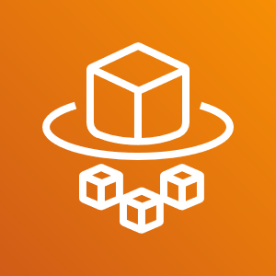
AWS Fargate
AWS Fargate is a technology for Amazon ECS that allows you to run containers without having to manage servers or clusters.
No Clusters to Manage
Seamless Scaling
Integrated with Amazon ECS
Flexible configuration options
Resource-based pricing
AWS Fargate
© 2024, Amazon Web Services, Inc. or its affiliates. All rights reserved.
Notes:
AWS Fargate is a technology for Amazon ECS that allows you to run containers without having to manage servers or clusters.
ECS can use containers provisioned by Fargate to automatically scale, load balance, and manage scheduling of your containers for availability, providing an easier way to build and operate containerized applications. This removes the need to choose server types, decide when to scale your clusters, or optimize cluster packing.
All Amazon ECS clusters are heterogeneous – you can run both Fargate and Amazon ECS tasks in the same cluster. Fargate capabilities are available natively in Amazon ECS, so you don’t need to learn new API actions or primitives to run containers on Fargate.
Fargate is available with 50 different combinations of CPU and memory to closely match your application needs. You can use 2 GB per vCPU anywhere up to 8 GB per vCPU for various configurations. You can easily match your workload requirements, whether they are general purpose, compute, or memory optimized.
You pay by the task size and only for the time for which resources are consumed by the task. The price for CPU and memory is charged on a per-second basis. There is a one-minute minimum charge.

Slide 29
AWS Fargate and the ECS stack
ECS Scheduling & Orchestration
Placement Engine
Cluster Manager
Task
ECS Agent
Docker Agent
ECS AMI
Task
ECS Agent
Docker Agent
ECS AMI
Managed by
AWS Customer
Managed by
AWS Fargate
© 2024, Amazon Web Services, Inc. or its affiliates. All rights reserved.
Notes:
What does it mean when we say “only worry about managing apps and services at the container level”? To better understand this it may help to visualize the components of the Fargate and ECS stack in a sample deployment.
First, ECS handles scheduling and orchestration, directed by the Task Definition created by a user. When a task definition is run, it is exposed by ECS as a task. Those components are still managed by the AWS Account Holder, or user, when Fargate is used. What changes is the fact that Fargate manages the placement engine, cluster management, and the infrastructure including agents, AMIs and more.
An easy use case to help visualize this is what happens when a new version of Docker is released. Today, the user has to think about an upgrade strategy and manually upgrade the version of Docker on each node in the cluster, requiring draining of that node and scheduled downtime. With Fargate, this is all taken care of on your behalf.

Slide 30
Using AWS Fargate
Define IAM and networking policies
4
Launch
3
Specify CPU and memory requirements
2
1
Build your container image
© 2024, Amazon Web Services, Inc. or its affiliates. All rights reserved.
Notes:
Amazon ECS has two modes:
EC2 launch type
AWS Fargate launch type
With Fargate launch type, all you have to do is package your application in containers, specify the CPU and memory requirements, define networking and IAM policies, and launch the application. Fargate manages all the scaling and infrastructure needed to run your containers in a highly available manner.
Running containers as Fargate or EC2 is a launch-time decision. There is no additional plugin to add to run your containers as Fargate.

Slide 31
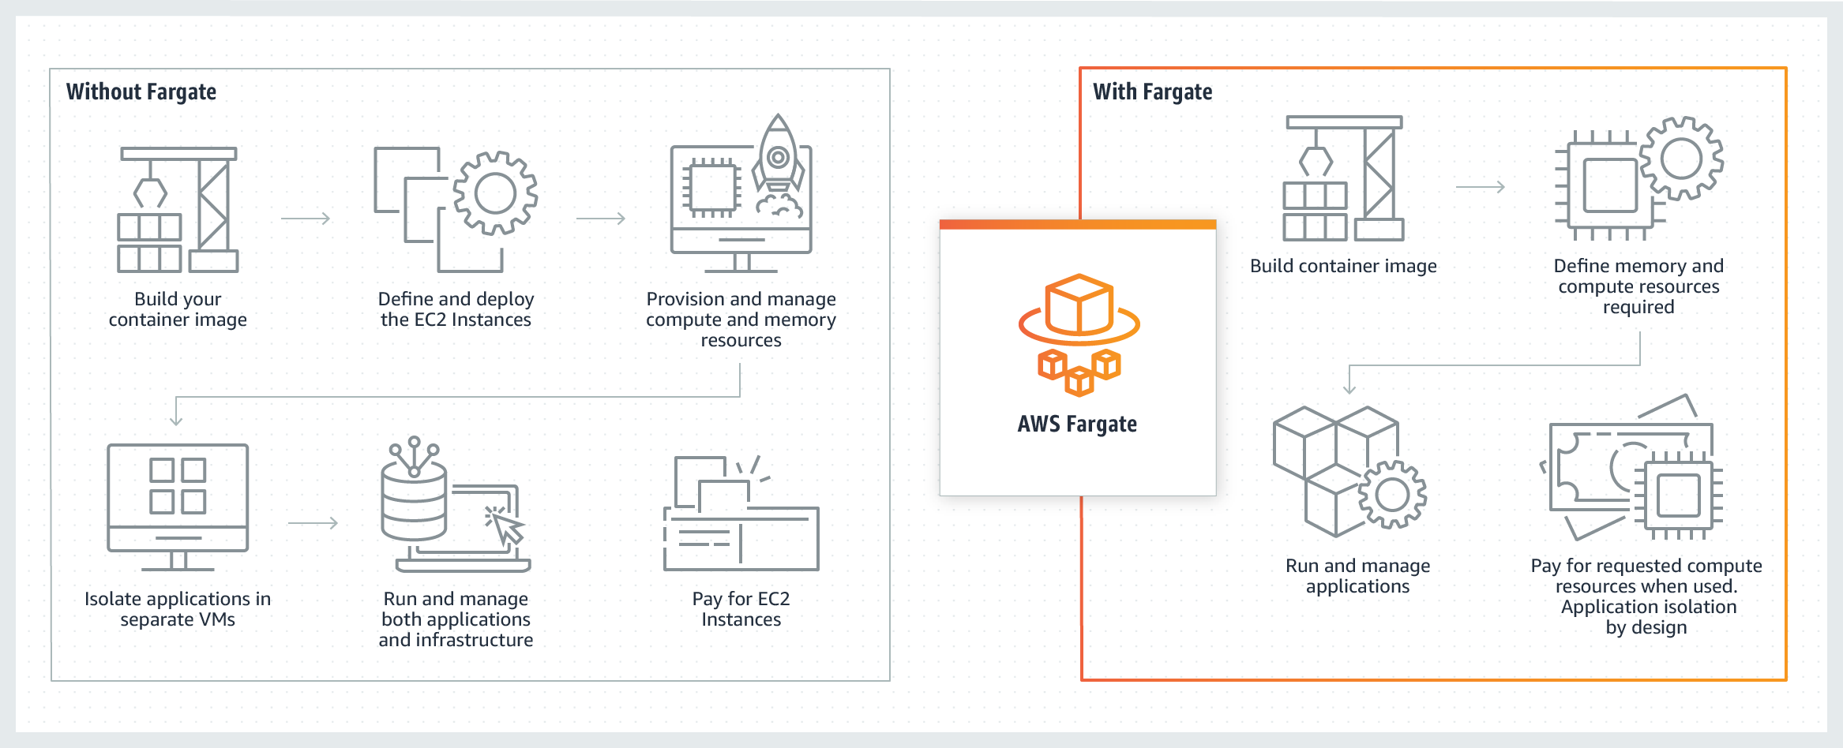
How it works
© 2024, Amazon Web Services, Inc. or its affiliates. All rights reserved.
Notes:
Amazon ECS has two modes:
EC2 launch type
AWS Fargate launch type
With Fargate launch type, all you have to do is package your application in containers, specify the CPU and memory requirements, define networking and IAM policies, and launch the application. Fargate manages all the scaling and infrastructure needed to run your containers in a highly available manner.
Running containers as Fargate or EC2 is a launch-time decision. There is no additional plugin to add to run your containers as Fargate.

Slide 32
When to use AWS Fargate over ECS
Use ECS when:
Using Spot or Reserved Instances
Running Windows Clusters
Needing more granular control for compliance
Requiring specialized hardware
Use Fargate when:
Running containers without managing a fleet of EC2 instances
Needing a quick start for a new app
Porting a monolithic app
Dealing with highly variable workloads
© 2024, Amazon Web Services, Inc. or its affiliates. All rights reserved.
Notes:
With AWS Fargate, you no longer have to provision, configure, and scale clusters of virtual machines to run containers.
If you want to get a service or app up and running quickly, Fargate is a great way to make this happen. Write your task definition, choose Fargate, and you are off and running. Everything else is managed for you.
Or, let’s say you need to quickly migrate a monolithic app to the cloud. By containerizing the app and then launching with Fargate, you can worry less about the cluster and focus on the app itself.
Another use case where Fargate helps is if your service or app is highly variable and un-predictable in the resources it may use over time. Since Fargate can add additional infrastructure capacity automatically, in the bounds you set, you don’t have to worry about your service running out of resources and becoming unavailable. Additionally, you don’t have to overprovision for the highest possible demand, and end up paying for resources you did not end up needing in the first place.
with EC2.

Slide 33
When to use ECS over AWS Fargate
Use ECS when:
Using Spot or Reserved Instances
Running Windows Clusters
Needing more granular control for compliance
Requiring specialized hardware
Use Fargate when:
Running containers without managing a fleet of EC2 instances
Needing a quick start for a new app
Porting a monolithic app
Dealing with highly variable workloads
© 2024, Amazon Web Services, Inc. or its affiliates. All rights reserved.
Notes:
If you are a heavy user of EC2 Spot, or you have paid for reserved instances, you may choose to use EC2 mode for your ECS tasks. Since Fargate is managing all the infrastructure on your behalf and charging by the CPU and Memory second consumed, there is not a way today to translate that to Spot or reserved instances.
If the services and apps you are deploying run on Microsoft Windows based containers, EC2 mode is still the best option for deployment. This allows you to use Windows based AMIs and configurations in your cluster, which is not currently supported by Fargate.
Finally, if you simply require more granular control of your EC2 instances (due to support compliance, governance requirements, broader customization options or specialized hardware) you will need to stick with EC2.

Slide 34
Kubernetes
Run applications at scale
Seamlessly move applications
Run anywhere
Add new functionality
Kubernetes is open source container management and orchestration software.
Use Kubernetes to:
Manage clusters of Amazon EC2 compute instances
Run containers on those instances with processes for deployment, maintenance, and scaling
© 2024, Amazon Web Services, Inc. or its affiliates. All rights reserved.
Notes:
Kubernetes is open-source container orchestration software that allows you to deploy and manage containerized applications at scale and run any type of containerized application by using the same toolset on-premises and in the cloud.
Kubernetes works by managing a cluster of compute instances.
It runs scheduling containers on the cluster, based on where compute resources are available, as well as the resource requirements of each container that you will run to support your applications.
Containers are run in logical groupings called pods, and you can run and scale one or many containers together as a pod.
Kubernetes control plane software decides when and where to run your pods, manages traffic routing, and scales your pods based on utilization or other metrics that you define.
Kubernetes automatically starts pods on your cluster based on their resource requirements. It automatically restarts pods if they, or the instances they are running on, fail.
Each pod is given an IP address and a single Domain Name System (DNS) name, which Kubernetes uses to connect your services with each other and external traffic.
Kubernetes lets you define complex containerized applications and run them at scale across a cluster of servers.
Applications can be seamlessly moved from local development machines to production deployments on the cloud by using the same operational tooling.
A key advantage of Kubernetes is that you can use it to run your containerized applications anywhere without needing to change your operational tooling.
As an open source project, adding new functionality to Kubernetes is easy.
A large community of developers and companies build extensions, integrations, and plugins that help Kubernetes users do more.

Slide 35



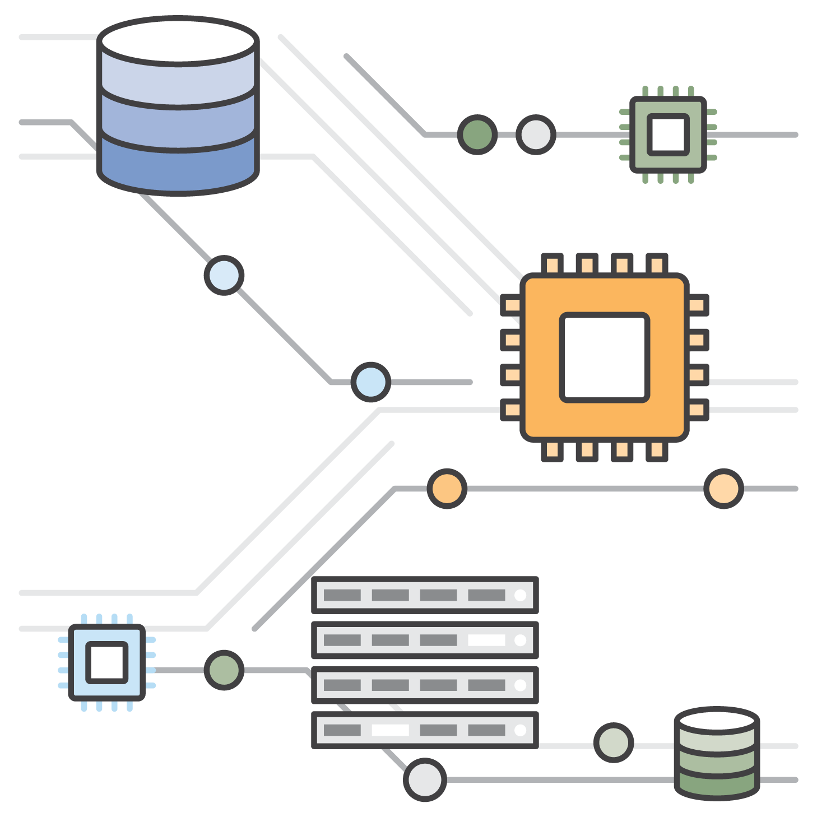
Amazon Elastic Container Service for Kubernetes (Amazon EKS)
1
Provision an Amazon EKS cluster
2
Deploy worker nodes
3
Connect to Amazon EKS
4
Run container applications
Amazon Elastic Container Service for Kubernetes
CONTROL PLANE
NODES
© 2024, Amazon Web Services, Inc. or its affiliates. All rights reserved.
Notes:
You can run Kubernetes on your AWS accounts. You can choose to manage the Kubernetes infrastructure yourself by running it on Amazon EC2 instances. Or, you can use an automatically provisioned, managed Kubernetes control plane with Amazon Elastic Container Service for Kubernetes (Amazon EKS).
Amazon EKS makes it easy to deploy, manage, and scale containerized applications using Kubernetes. It runs the Kubernetes management infrastructure for you across multiple AWS Availability Zones to eliminate a single point of failure. Amazon EKS is certified Kubernetes conformant, so you can use existing tooling and plugins from partners and the Kubernetes community. Applications that run on any standard Kubernetes environment are fully compatible and can be migrated to Amazon EKS.
The diagram shows how Amazon EKS works:
Provision an Amazon EKS cluster. Amazon EKS automatically deploys a Kubernetes control plane.
Deploy worker nodes. Add the number of worker nodes that you need to your Amazon EKS cluster.
Connect to Amazon EKS. Point your preferred Kubernetes tooling at your Amazon EKS cluster.
Run Kubernetes applications. Deploy your Kubernetes applications to your Amazon EKS cluster.

Slide 36
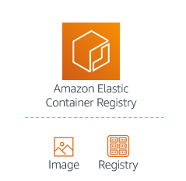


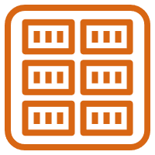
Amazon Elastic Container Registry (Amazon ECR)
Amazon ECR is a fully managed Docker container registry that makes it easy for developers to store, manage, and deploy Docker container images.
Amazon elastic container service integration
Docker support
High availability and durability
Team collaboration
Access control
Encryption at rest
Third-party integrations
Amazon Elastic Container Registry
Image
Registry
© 2024, Amazon Web Services, Inc. or its affiliates. All rights reserved.
Notes:
Amazon Elastic Container Registry (Amazon ECR) is a fully managed Docker container registry that makes it easy for developers to store, manage, and deploy Docker container images. It is integrated with Amazon ECS, so you can store, run, and manage container images for applications that run on Amazon ECS. Specify the Amazon ECR repository in your task definition, and Amazon ECS will retrieve the appropriate images for your applications.
Amazon ECR supports Docker Registry HTTP API version 2, which allows you to interact with Amazon ECR by using Docker CLI commands or your preferred Docker tools. In this way, you can maintain your existing development workflow and access Amazon ECR from any Docker environment, whether in the cloud, on premises, or on your local machine.
Amazon ECR stores your container images in Amazon S3 so it benefits from the high availability and durability of Amazon S3.
You can define and organize repositories in your Amazon ECR registry by using namespaces. This allows you to organize your repositories based on your team’s existing workflows. You can also set the API actions that another user can perform on your repository, which allows you to easily share your repositories with different users and AWS accounts.
Amazon ECR uses IAM for access control, so you can control who and what (e.g., EC2 instances) can access your container images through defined policies.
You can transfer your container images to and from Amazon ECS via HTTPS. Your images are also automatically encrypted at rest using Amazon S3 server-side encryption.
Finally, Amazon ECR also supports third-party integrations.

Slide 37

Key Takeaway
Containers hold everything that the software needs to run.
Docker is a software platform that packages software into containers.
A single application can span multiple containers.
Kubernetes is an open source container orchestration software.
Notes:
Some key takeaways from this section include:
Containers hold everything that the software needs to run, such as libraries, system tools, code, and the runtime.
Docker is a software platform that packages software (such as applications) into units that are called containers.
A single application can span multiple containers.
Kubernetes is an open source container orchestration software that allows you to deploy and manage containerized applications at scale.

